Slide 1


Package Delivery Optimization
-JIYA PATEL 24ITK035 CSE
- ADITYA JAIN 24ITK058 CSE+MBA
SEM1

Slide 2
CONTENTS
• Introduction
• Objectives
• Algorithm
• Flowchart
• Implementation
• Result/ Output

Slide 3
INTRODUCTION
•Objective: To find the shortest route for delivering packages across multiple cities.
•Key Idea: Minimize total distance traveled while ensuring every city is visited.

Slide 4
OBJECTIVES
Scenario: A courier company needs to deliver packages to several places.
Objectives: An efficient method to find the shortest distance between multiple places(<=10) to save fuel & decrease time spent.
Input: Number of places, their names, and distances (matrix).
Output: Optimal route covering all places and total distance.

Slide 5
ALGORITHM
Start
Input the num of places (max 10), distances between each place in a 2D matrix, fuel data (fuel capacity & average fuel consumption).
Input starting place (in the form of 1 to n , index of starting place = start - 1).
Repeat from 6 to 11 until all the places are visited.
current place = starting place, current fuel = fuel capacity.
Initialize an array named visited and mark it one for the starting place and all the other places visited.
Repeat 8 to 11 to find the nearest unvisited places.

Slide 6
ALGORITHM
8. If the place is not visited AND the distance between the current place and the unvisited place is the least then — store the distance in a temp variable.
9. If no such unvisited places are found — break.
10. If fuel range (avg fuel consumption * fuel capacity) is less than the distance then adivce for refueling in the same city.
10. Find the sum of all such temporary variables to find the min distance between the given places.
11. Update current place as the nearest unvisited place also update the fuel capacity as per the used fuel.
12. End

Slide 7
START
FLOW CHART
Input the variable no_of_cities and an array city_name[ ]
Input the distance matrix distance[ ][ ]
Input Avg Fuel consumption and Fuel capacity
visited [ ] = 0
total_distance = 0
current_city= start
current_city=fuel_capacity
Find the nearest_city with the smallest distance from current_city in the distance[][] matrix
If If all cities are visited (visited[] == 1 for all cities),
total_distance = total_distance + distance[current_city][nearest_city]
Print the route followed
and
total_distance
Print (Refuel here)
current_fuel = fuel_capacity;
if current_fuel * avg_fuel_consumption < min_distance
END
total_distance = total_distance + distance[current_city][nearest_city]
visited[nearest_city] = 1
current_city = nearest_city

Slide 8
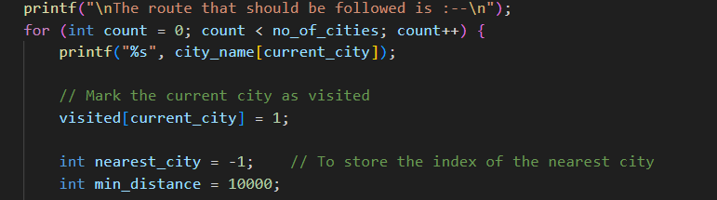

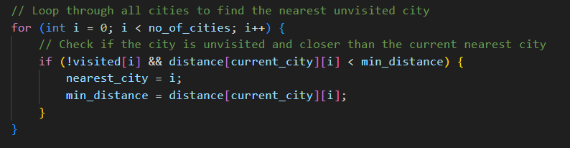
IMPLEMENTATION
Initialize the variables(like nearest city and minimum distance and mark the current city ie: the starting city entered by the user as 1.
Looping thorough the cities to find the nearest unvisited city and store its distance.

Slide 9

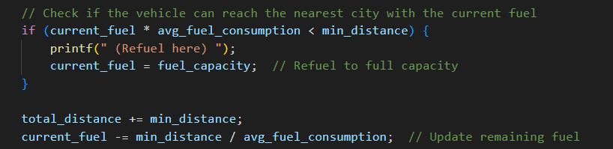
IMPLEMENTATION
If no unvisited city found exit from the loop
If the distance covered by the vehicle is less than the distance covered to reach the destination advice him to refuel.

Slide 10
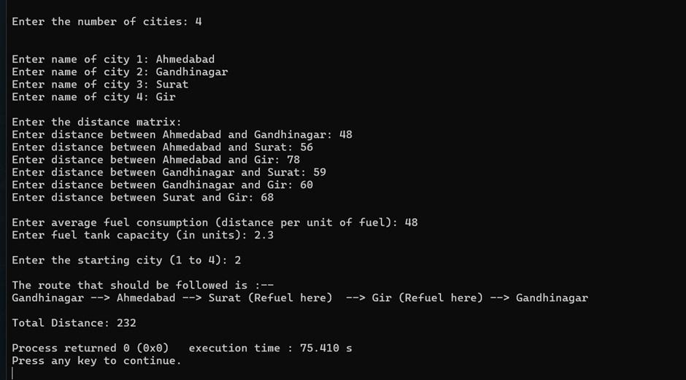
RESULT / OUTPUT

